Slide 1

ABE 715
Computer Programming
Lecture 15: Geospatial Data Analysis
Python for GIS: GeoPandas & Rasterio
Dr. Kadeghe G. Fue
Department of Agricultural Engineering
1

Slide 2






Beyond "Clicking Buttons"
Automation
Scale
Integration
Traditional GIS (ArcGIS, QGIS) relies on manual clicking. Python scripts can process 1,000 satellite images in minutes.
Handle massive datasets that would crash standard desktop software by processing data in chunks.
Directly feed spatial data into crop models or machine learning algorithms without exporting files.
2

Slide 3

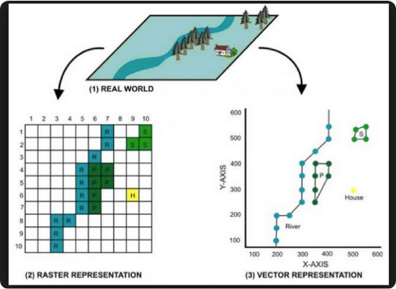
The Two Worlds of GIS
1. Vector Data
Discrete geometries. Points (Wells), Lines (Rivers), Polygons (Fields).
Library: GeoPandas
2. Raster Data
Continuous grids of values. Satellite imagery, Elevation (DEM), Temperature maps.
Library: Rasterio
3

Slide 4

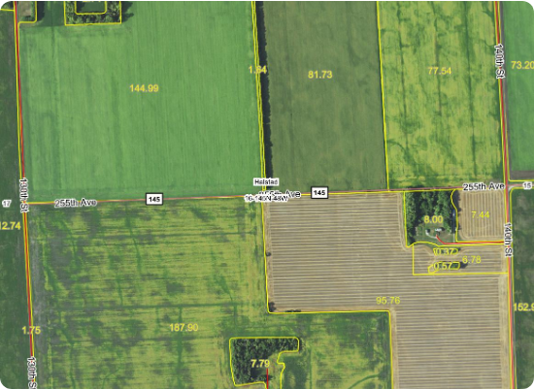
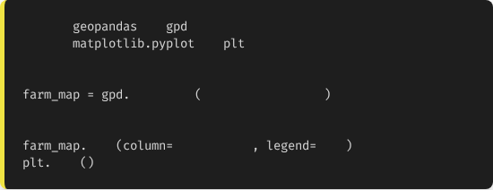
Tool 1: GeoPandas (Vector)
Pandas with Geometry
GeoPandas adds a special geometry column to standard DataFrames.
It can read/write Shapefiles (.shp) and GeoJSON.
import
as
import
as
# Load a shapefile of Fields
read_file
"farm_blocks.shp"
# Quick Plot
plot
"crop_type"
True
show
4

Slide 5

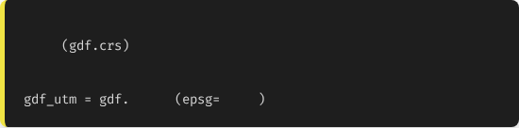
The Critical Concept: CRS
Latitude/Longitude vs Meters
Geographic CRS (EPSG:4326): Uses Degrees. Good for location, bad for measuring area (distortion).
Projected CRS (e.g., UTM Zone 37S): Uses Meters. Essential for calculating field size (hectares).
# Check CRS
print
# Reproject to UTM (Meters) for Area Calc
to_crs
32737
5

Slide 6
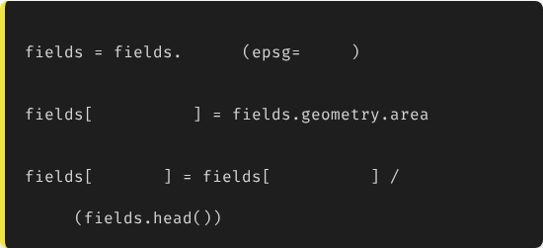
Case Study 1: Calculating Farm Area
Automation
Imagine you have a shapefile with 500 smallholder plots. We need the area of each in Acres.
# 1. Project to meters (UTM 37S)
to_crs
32737
# 2. Calculate Area (sq meters)
"area_sqm"
# 3. Convert to Acres
"acres"
"area_sqm"
4046.86
print
6

Slide 7
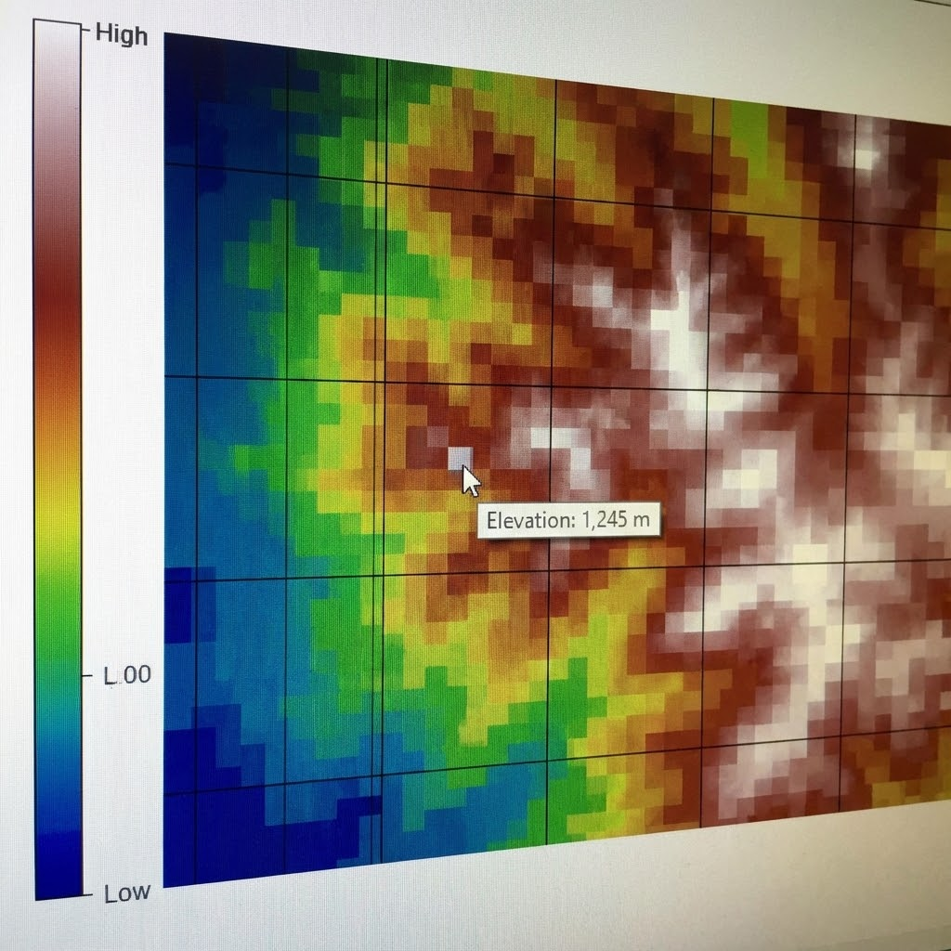
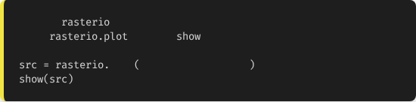
Tool 2: Rasterio (Raster)
Handling Imagery
Used for satellite images (Sentinel/Landsat) or Drone Data (DEM).
Digital Elevation Model (DEM): Each pixel represents the height above sea level.
import
from
import
open
"morogoro_dem.tif"
7

Slide 8
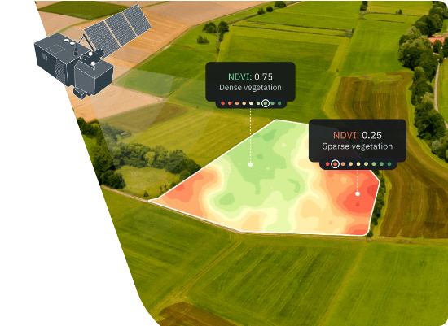
Case Study 2: Vegetation Health (NDVI)
Calculating NDVI
Normalized Difference Vegetation Index (NDVI) measures plant health using Near-Infrared (NIR) and Red bands.
Formula: (NIR - Red) / (NIR + Red)
We can perform this math directly on Raster arrays using NumPy, treating images as matrices.
8

Slide 9
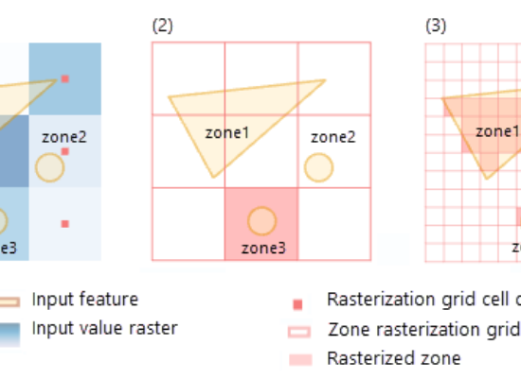
Combining Vector & Raster
Zonal Statistics
The bridge between the two data types.
Scenario: You have a Rainfall Raster map and a Polygon map of Districts.
Goal: Calculate the Average Rainfall per District.
Library: `rasterstats`
This aggregates pixel values within each boundary.
9

Slide 10
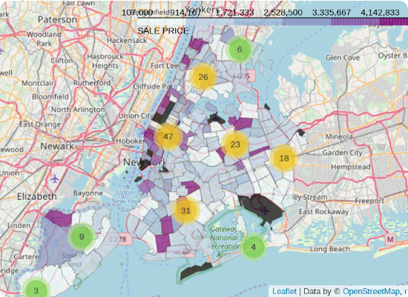
Visualization: Interactive Maps
Folium
Python wrapper for Leaflet.js. Creates interactive HTML maps you can zoom and pan.
•
Add Satellite tiles.
•
Add markers for sensor locations.
•
Export as map.html to share with stakeholders.
10

Slide 11
GIS Best Practices
Always Check CRS: Trying to overlay two maps with different projections is the #1 error in GIS. Always use .to_crs() to align them.
Vector for Precision: Use Shapefiles for legal boundaries, infrastructure, and asset locations.
Raster for Continuous: Use Tiffs for environmental variables (Soil, Elevation, Climate, Yield Maps).
11

Slide 12

Lecture 15: Take-Home Assignment
The Land Surveyor
Scenario: You are given a GeoJSON file sua_farm_blocks.geojson containing the boundaries of 5 research blocks.
Task: Write a Python script using GeoPandas to:
Load the GeoJSON file.
1.
Check the CRS. If it is in Degrees (Lat/Lon), convert it to UTM Zone 37S (EPSG:32737).
2.
Calculate the area of each block in Hectares.
3.
Print the name of the largest block.
4.
5.
Save the result as a new file: processed_blocks.shp.
12

Slide 13
Questions?
Next Class: Final Course Review & Future Trends
Dr. Kadeghe G. Fue
Department of Agricultural Engineering
13

